Slide 1

Visual Studio Code for Azure Developers, Consultants and Architects
Abhijit Jana
https://abhijitjana.net | https://dailydotnettips.com | me@abhijitjana.net

Slide 2
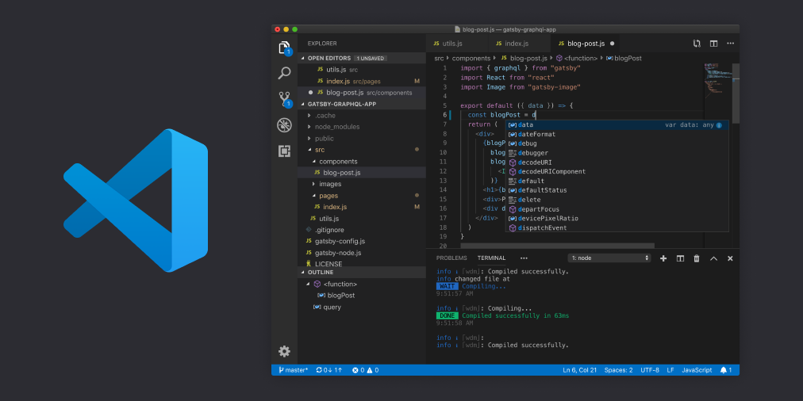
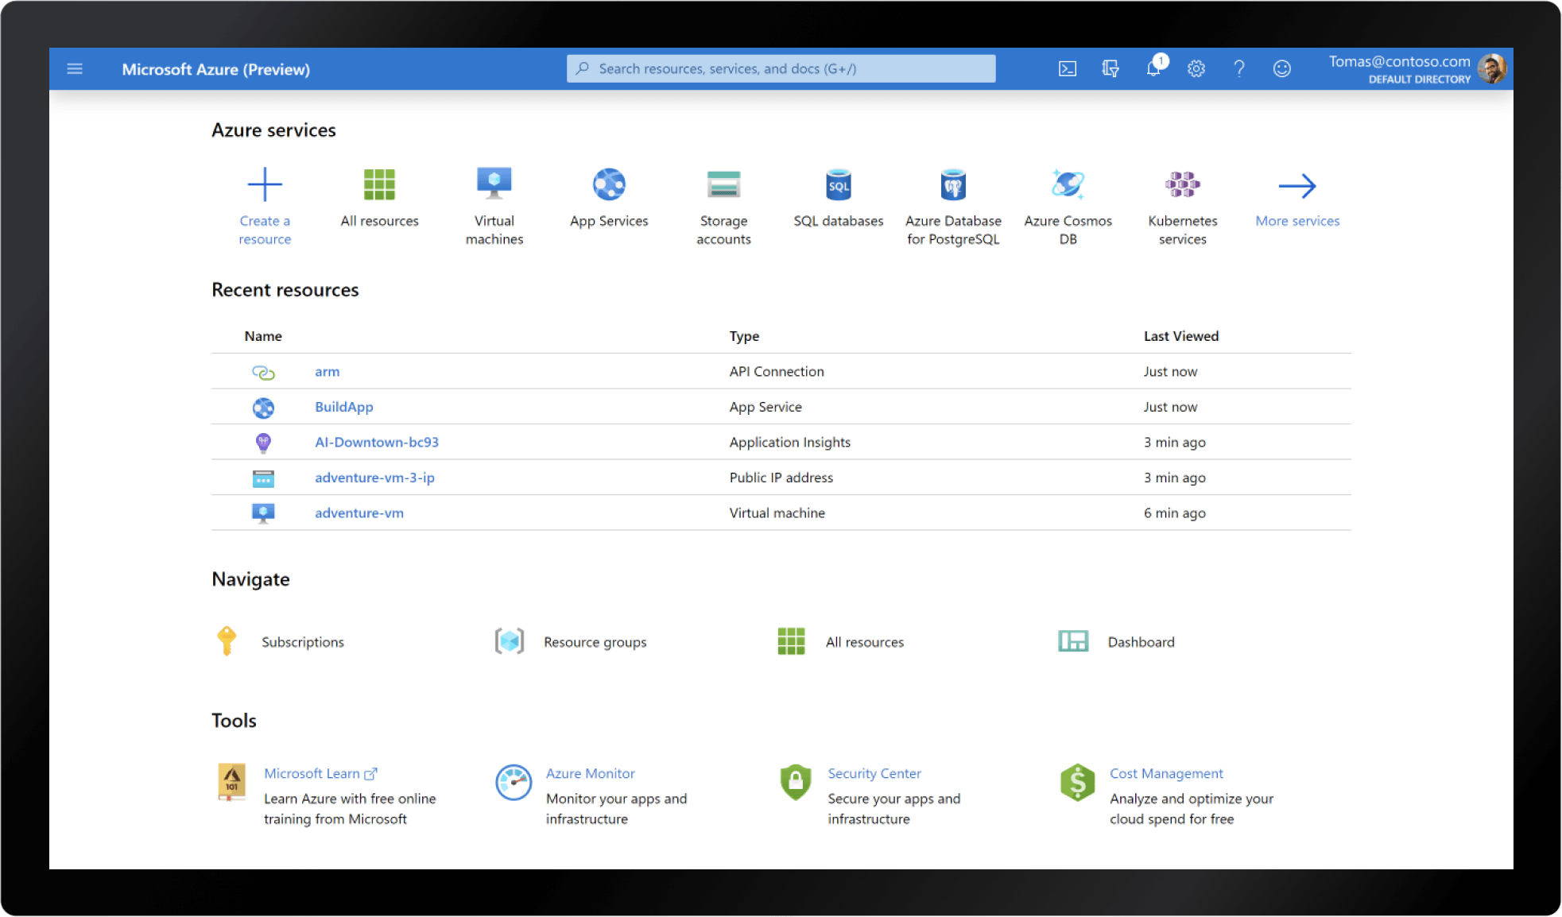
What You Need !!
Visual Studio Code : https://code.visualstudio.com/download
Create Azure Free Account : https://azure.microsoft.com/en-in/free/

Slide 3


Demo
Let’s see it in Action !!

